Slide 1
Data Science UNIT-1 Data Preprocessing I-Data Cleaning, II-Data Integration, III-Data Reduction, III-Data Transformation and Data Discretization,

Slide 2
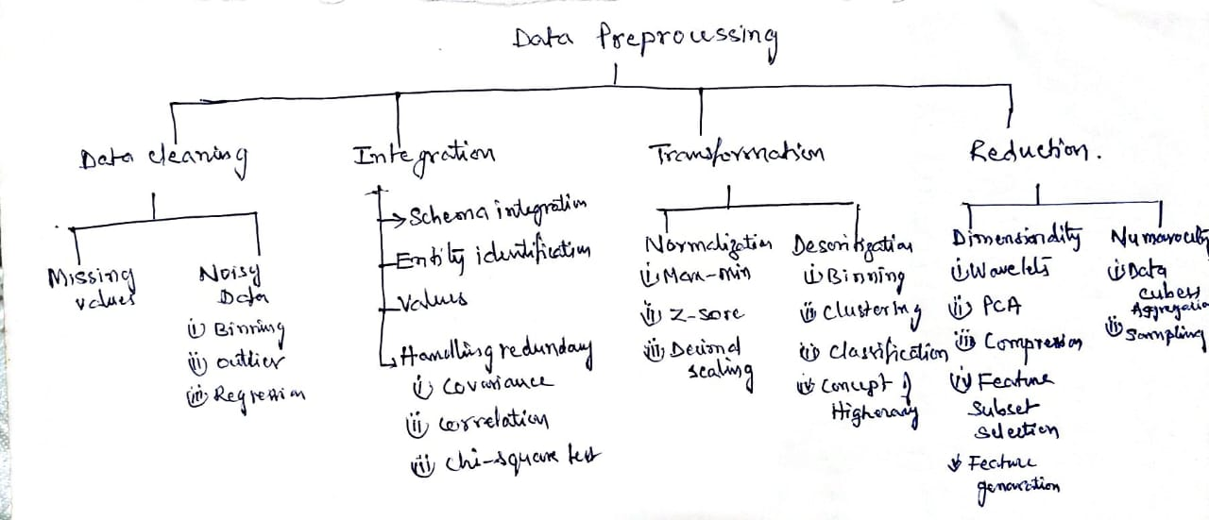

Slide 3
Data Quality: Why Preprocess the Data?
There are many factors/measures comprising data quality
Measures for data quality: A multidimensional view
Accuracy: correct or wrong, accurate or not, errors from instruments , data transmission errors
Completeness: not recorded, unavailable, user interested attributes may not be available causing unfilled data
Consistency: some modified but some not, dangling, …
Timeliness: timely update? Several sales representatives, however, fail to submit their sales records on time at the end of the month.
For a period of time following each month, the data stored in the database are incomplete.
However, once all of the data are received, it is correct.
Believability: how trustable the data are correct?
Interpretability: how easily the data can be understood?
Suppose that a database, at one point, had several errors, all of which have since been corrected.
The data also use many accounting codes, which the sales department does not know how to interpret. Even though the database is

Slide 4
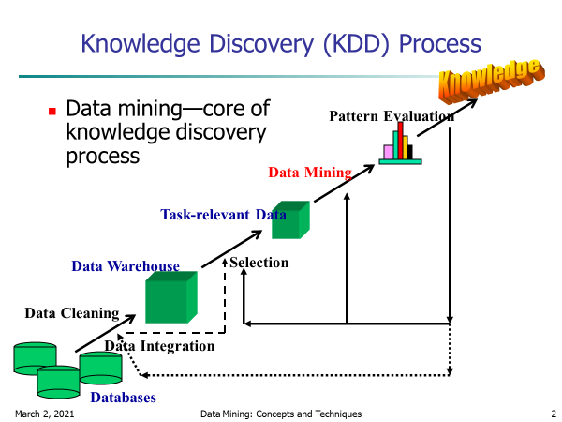
Data Mining as Knowledge Discovery
Data cleaning - to remove noise or irrelevant data
Data integration - where multiple data sources may be combined
Data selection- where data relevant to the analysis task are retrieved from the database
Data transformation -where data are transformed or consolidated into forms appropriate for mining by
performing summary or aggregation operations
Data mining - an essential process where intelligent methods are applied in order to extract data patterns
Pattern evaluation to identify the truly interesting patterns representing knowledge based
Knowledge presentation -where visualization and knowledge representation techniques are used to present

Slide 5
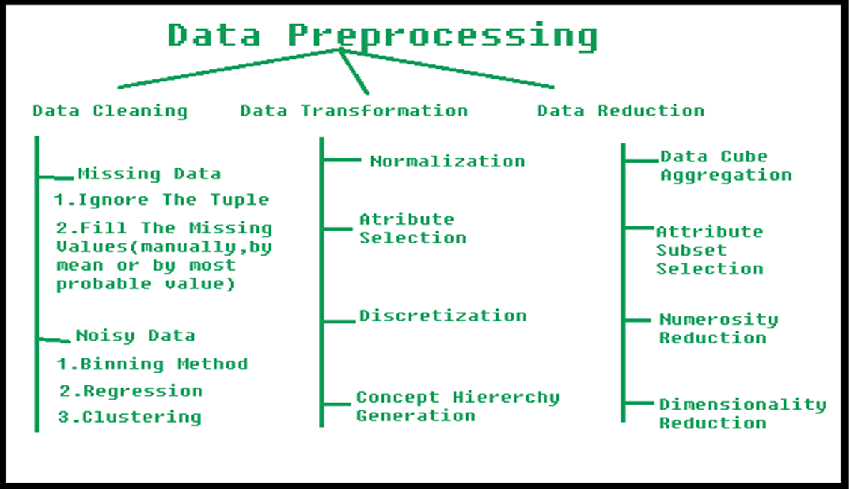
Major Tasks/Steps in Data Preprocessing
Data cleaning
Fill in missing values, smooth noisy data,
identify or remove outliers, and resolve inconsistencies
Data integration
Integration of multiple databases, data cubes, or files
Data reduction
Dimensionality reduction
Numerosity reduction
Data compression
Data transformation and data discretization
Normalization
Concept hierarchy generation

Slide 6
I-Data Cleaning

Slide 7
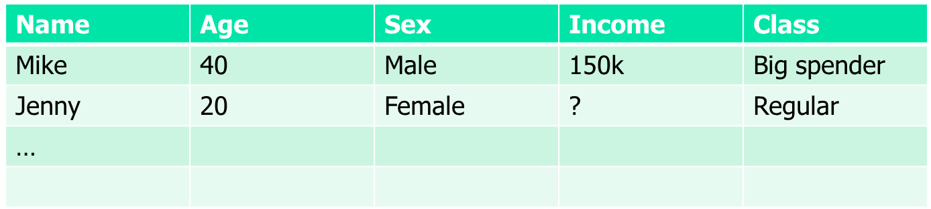
I- Data Cleaning: Incomplete (Missing) Data
Data is not always available
E.g., many tuples have no recorded value for several attributes, such as customer income in sales data
Missing data may be due to
equipment malfunction
inconsistent with other recorded data and thus deleted
data not entered due to misunderstanding
certain data may not be considered important at the time of entry
not register history or changes of the data
Missing data may need to be inferred

Slide 8
Data Cleaning: How to Handle Missing Data?
Ignore the tuple: usually done when class label is missing (when doing classification)—not effective when the % of missing values per attribute varies considerably
Fill in the missing value manually: tedious + infeasible?
Fill in it automatically with
a global constant : e.g., “unknown”, a new class?!
the attribute mean
the attribute mean for all samples belonging to the same class: smarter
the most probable value: inference-based such as Bayesian formula or decision tree, or use regression to fill

Slide 9
Data Cleaning: Noisy Data
Noise: random error or variance in a measured variable
Incorrect attribute values may be due to
faulty data collection instruments
data entry problems
data transmission problems
technology limitation
inconsistency in naming convention
Other data problems which require data cleaning
duplicate records
incomplete data
inconsistent data
9
Notes:
9

Slide 10
Data Cleaning: How to Handle Noisy Data?
Binning
first sort data and partition into (equal-frequency) bins
then one can smooth by bin means, smooth by bin median, smooth by bin boundaries, etc.
Regression
smooth by fitting the data into regression functions
Clustering/Outlier
detect and remove outliers
Combined computer and human inspection
detect suspicious values and check by human (e.g., deal with possible outliers)

Slide 11
Data Cleaning: Handling Noisy Data: Binning
“Data smoothing is the technique to handle noisy data
“smooth” out the data to remove the noise
data smoothing techniques.
Binning
Regression
Outlier analysis
Binning:
This method works on sorted data
The sorted data is divided into equal frequency buckets/bins
Binning is of three types:
smoothing by bin means
each value in a bin is replaced by the mean value of the bin.
smoothing by bin medians
each bin value is replaced by the bin median.
smoothing by bin boundaries
the minimum and maximum values in a given bin are identified as the bin boundaries.
Each bin value is then replaced by the closest boundary value.

Slide 12
Data Cleaning: Binning methods
Equal-width (distance) partitioning
Divides the range into N intervals of equal size: uniform grid
if A and B are the lowest and highest values of the attribute, the width of intervals will be: W = (B –A)/N.
The most straightforward, but outliers may dominate presentation
Skewed data is not handled well
Equal-depth (frequency) partitioning
Divides the range into N intervals, each containing approximately same number of samples
Good data scaling
Managing categorical attributes can be tricky

Slide 13
Data Cleaning: Binning Example:
Sorted data for price (in dollars): 4, 8, 15, 21, 21, 24, 25, 28, 34
Partition into (equal-frequency-length 3) bins:
Bin1: 4,8,15 (max=15, min=4)
Bin 2: 21, 21, 24 (max=24, min=21)
Bin 3: 25, 28, 34 (max=34,min=25)
Smoothing by bin means:
Bin1: 9,9,9. (mean of Bin1=4+8+15/3 =9)
Bin 2: 22, 22, 22 (mean of Bin2=21+21+24/3 =22)
Bin 3: 29, 29, 29
Smoothing by bin boundaries:
Bin 1: 4,4,15. ( 4 is closer to min=4,replace 4 by 4. 8 is closer to min=4
so replace 8 by 4, 15 is closer to max=15,replace 15 by 15)
Bin 2: 21, 21, 24
Bin 3: 25, 25, 34
Use |x2-x1| as
closeness measure

Slide 14
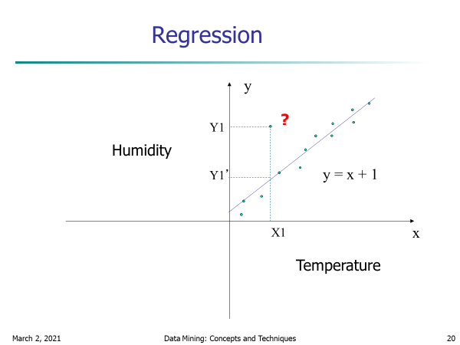

Data Cleaning: Handling Noisy Data: Regression
Regression: Data smoothing can also be done by regression, a technique that conforms data values to a function.
Linear regression involves finding the “best” line to fit two attributes (or variables) so that one attribute can be used to predict the other.
Y=mX+c
Multiple linear regression is an extension of linear regression, where more than two attributes are involved and the data are fit to a multidimensional surface.
Y=m1X1+m2X2+c
Example:
Using various normal equations of
Stats the best fitted line can be Y=2X.
Use Y=2X to predict the correct value at X=3
Which is 6 and replace(smooth) 5.6 by 6
X | 0 | 1 | 2 | 3 | 4
Y | 0 | 2 | 4 | 5.6 | 8
Error data

Slide 15
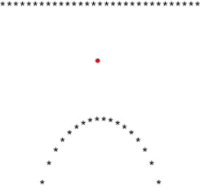
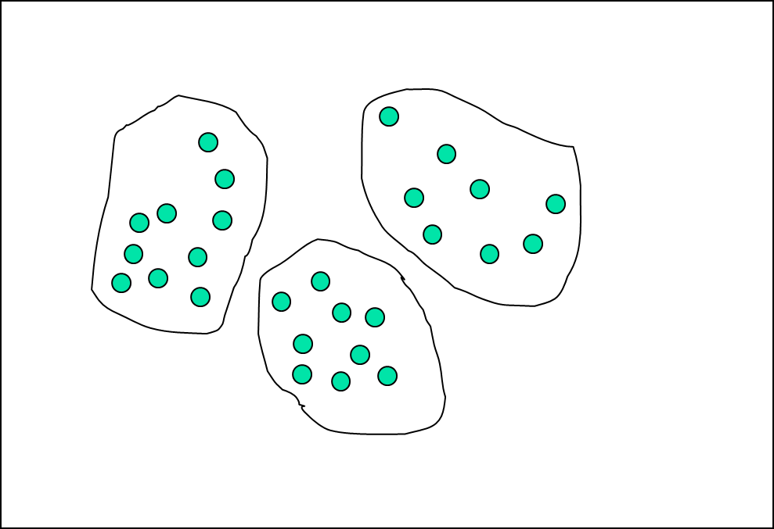
Data Cleaning: Handling Noisy Data: Outlier analysis
Outlier analysis: Outliers may be detected by clustering,
where similar values are organized into groups, or “clusters.”
Intuitively, values that fall outside of the set of clusters may be considered outliers
When Y=X and Y=X2 are fitted then the
Points satisfying these two equations
are taken as two clusters and the errored value 0.5
Which is not into any cluster is identified as outlier .
X | 0 | 1 | 2 | 3 | 4
Y=x | 0 | 1 | 0.5 | 3 | 4
Y=x² | 0 | 1 | 0.5 | 9 | 16
Outlier=0.5

Slide 16
Data Cleaning: ETL (Extraction/Transformation/Loading) : RAPID MINER:
RapidMiner is a data science software platform developed by the company of the same name that provides an integrated environment for data preparation, machine learning, deep learning, text mining, and predictive analytics.
RapidMiner provides data mining and machine learning procedures including: data loading and transformation (ETL),
Data pre-processing and visualization, predictive analytics and statistical modelling, evaluation, and deployment.
RapidMiner is written in the Java programming language.
RapidMiner provides a GUI to design and execute analytical workflows.
Those workflows are called “Processes” in RapidMiner and they consist of multiple “Operators”.
Each operator performs a single task within the process, and the output of each operator forms the input of the next one
Documentation link: https://docs.rapidminer.com/

Slide 17
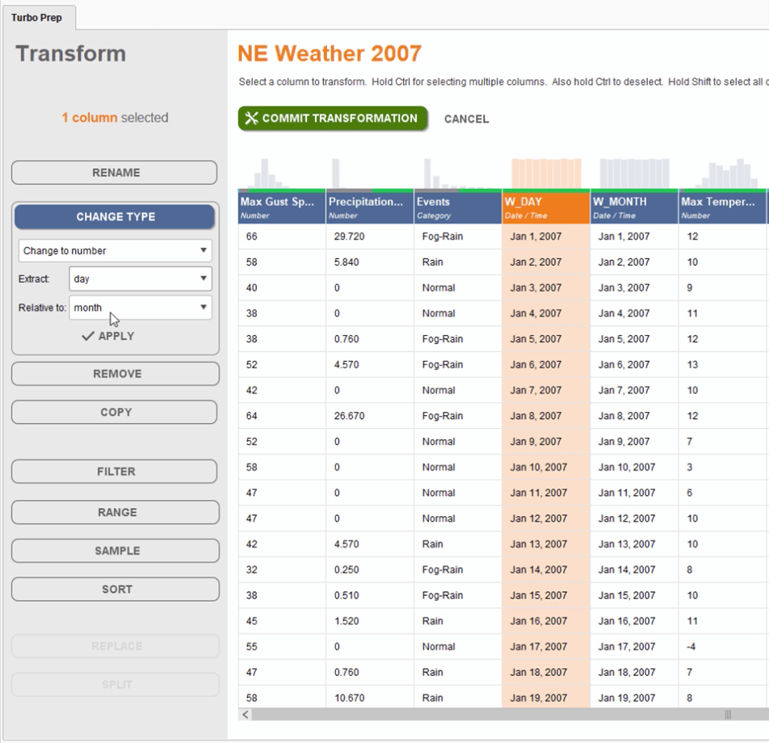
Data Cleaning: Snapshot of rapid miner : ETL (Extraction/Transformation/Loading)

Slide 18
Handle missing values -Cleaning and Munging
During cleaning and munging in data science, handling missing values is one of the most common tasks. The real-life data might contain missing values which need a fix before the data can be used for analysis. We can handle missing values by:
Either removing the records that have missing values or
Filling the missing values using some statistical technique or by gathering data understanding.
A rule of thumb is that you can drop the missing values if they make up for less than five percent of the total number of records but however it depends on the analysis, the importance of the missing values, the size of the data, and the use case we are working on.

Slide 19
Manipulating Data
Data Manipulation Meaning: Manipulation of data is the process of manipulating or changing information to make it more organized and readable.

Slide 20
Hypothesis and Inference
Statistical Inference
Using data analysis and statistics to make conclusions about a population is called statistical inference.
The main types of statistical inference are:
Estimation
Hypothesis testing
Hypothesis testing is a method to check if a claim about a population is true. More precisely, it checks how likely it is that a hypothesis is true is based on the sample data.

Slide 21
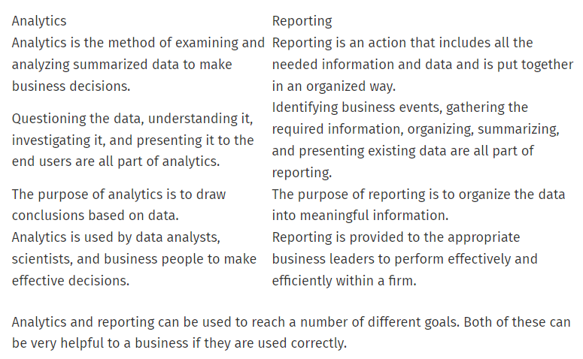
Analysis and reporting

Slide 22
II-Data Integration

Slide 23
Data Integration:
Data integration:
Combines data from multiple sources into a coherent store.
Approaches in Data Integration
1. Entity identification problem:
2. Tuple Duplication:
3. Detecting and resolving data value conflicts
4. Redundancy and Correlation Analysis

Slide 24
1. Entity identification problem
Schema integration:
Mismatching attribute names
Identify real world entities from multiple data sources,
e.g., Bill Clinton = William Clinton
e.g., A.cust-id ≡ B.cust-#
Integrate metadata from different sources
Object matching: Mismatching structure of data
Ex: Discount issues
Currency type

Slide 25
2. Tuple Duplication:
Name | DOB | Branch | Occupation | Address
A | 25 | HYD | Govt | TPG
B | 30 | TH | Govt | RJY
A | 25 | HYD | Private | TPG
D | 30 | IBP | Private | RJY
The use of denormalized tables is another source of data redundancy. Inconsistencies often arise between various duplicates due to inaccurate data entry.

Slide 26
3. Detecting and resolving data value conflicts
For the same real world entity, attribute values from different sources are different.
Possible reasons:
different representations, Ex: Total sales for month single store/all stores
different scales, e.g., metric vs. British units (e.g., GPA in US and China)

Slide 27
4. Redundancy and Correlation Analysis
Redundant data occur often when integration of multiple databases
Object identification: The same attribute or object may have different names in different databases
Derivable data: One attribute may be a “derived” attribute in another table, e.g., annual revenue
Redundant attributes may be able to be detected by correlation analysis
Careful integration of the data from multiple sources may help reduce/avoid redundancies and inconsistencies and improve mining speed and quality

Slide 28
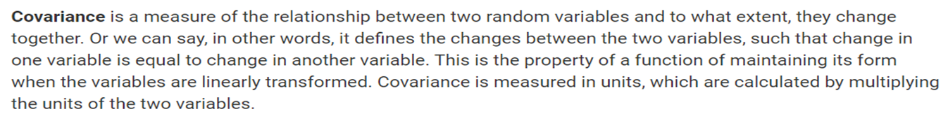
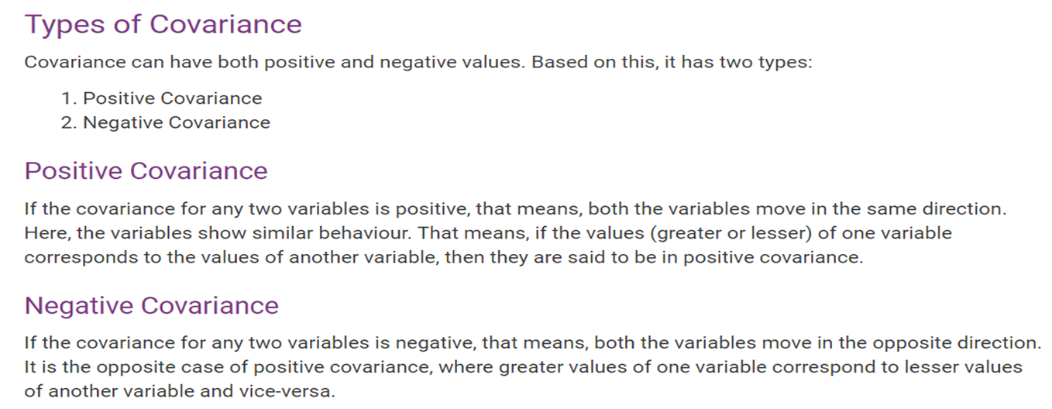
4. Redundancy and Correlation Analysis

Slide 29
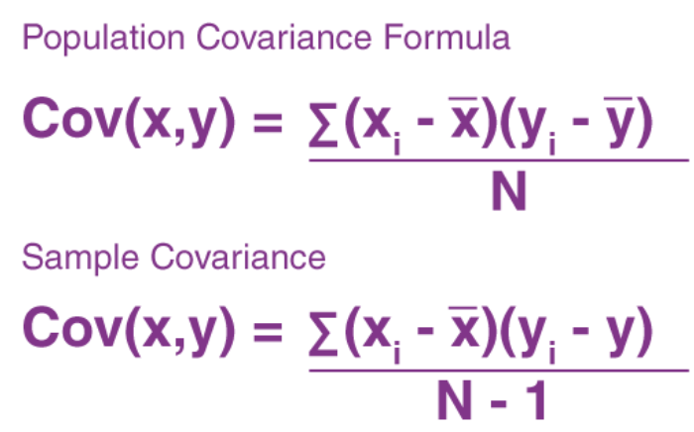
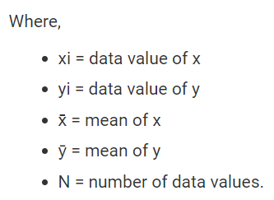
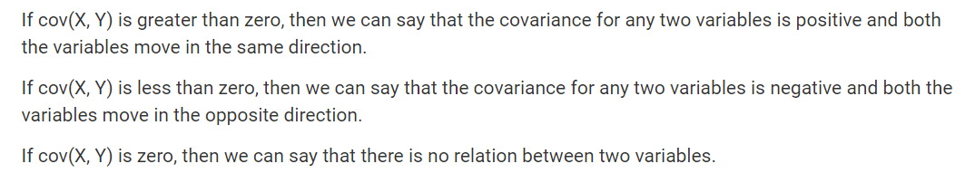

Slide 30
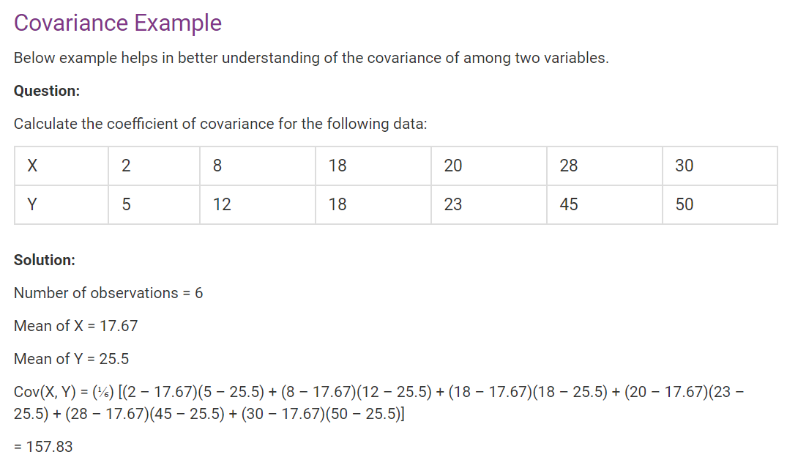

Slide 31
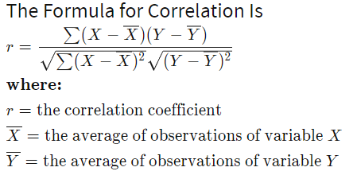
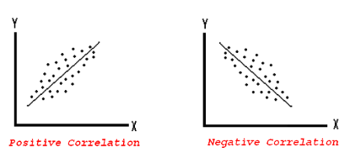
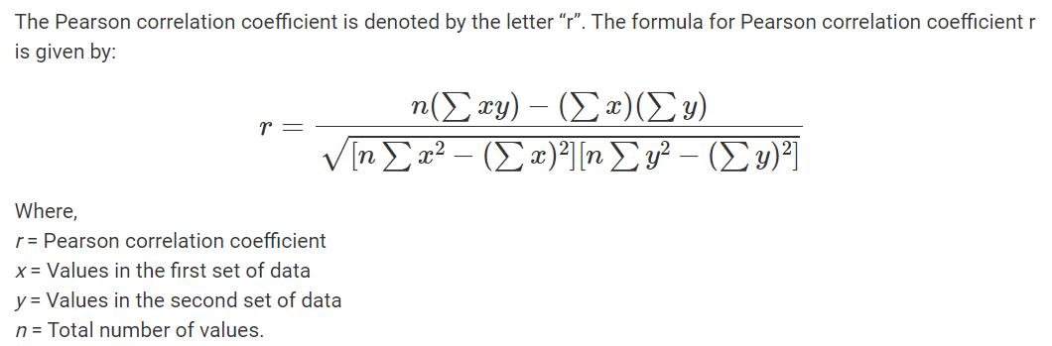
4. Redundancy and Correlation Analysis
Correlation
Correlation analysis is a method of statistical evaluation used to study the strength of a relationship between two, numerically measured, continuous variables.
Computed as Correlation co-efficient
Value ranges between – (-1) to (+1)
Positively Correlated, Negatively correlated, Not correlated
The strength of a correlation indicates how strong the relationship is between the two variables. The strength is determined by the numerical value of the correlation

Slide 32
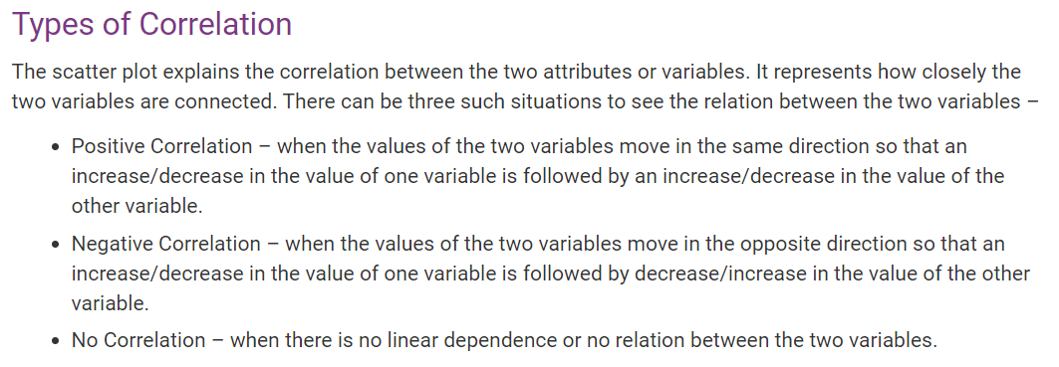

Slide 33
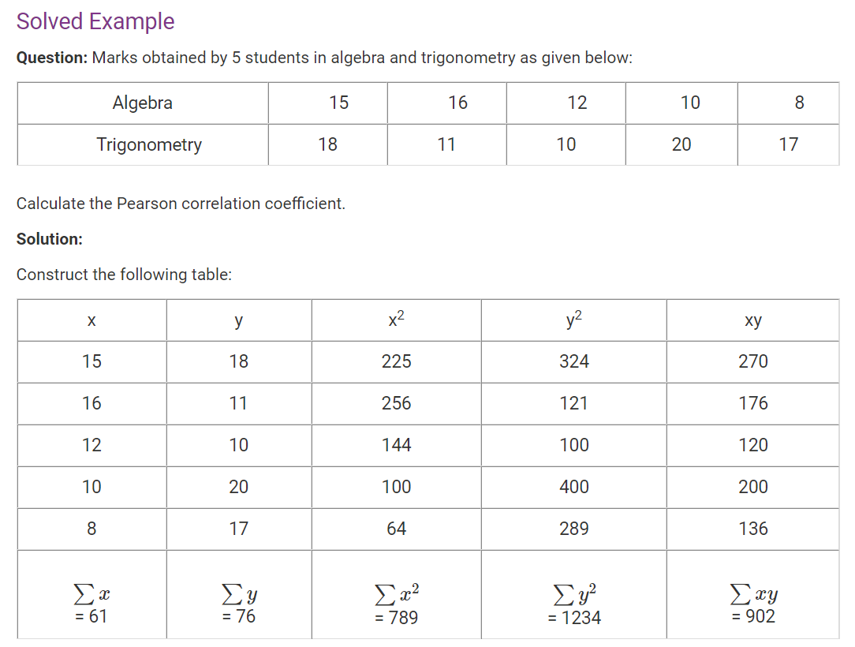
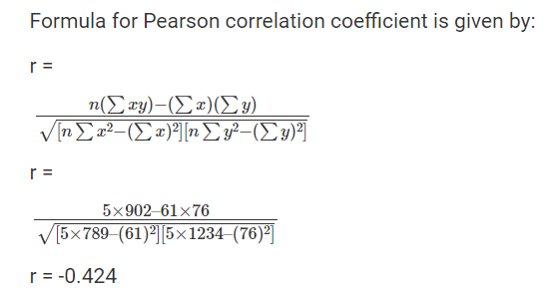

Slide 34
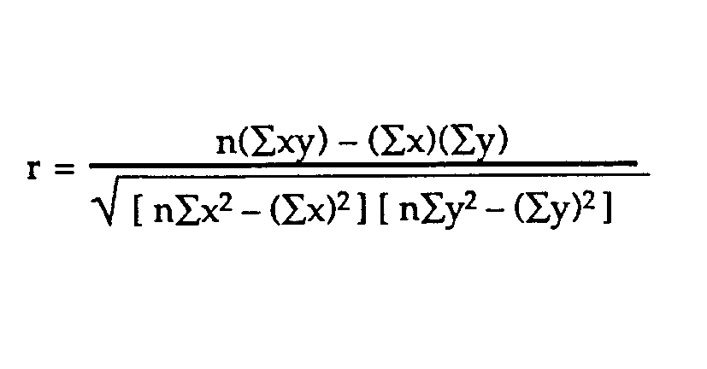
Example problem:
Business problem: The healthcare industry want to develop a
medication to control glucose levels. For this it want to study does age
have impact on raise in glucose levels
SUBJECT | AGE X | GLUCOSE LEVEL Y | XY | X² | Y²
1 | 43 | 99 | 4257 | 1849 | 9801
2 | 21 | 65 | 1365 | 441 | 4225
3 | 25 | 79 | 1975 | 625 | 6241
4 | 42 | 75 | 3150 | 1764 | 5625
5 | 57 | 87 | 4959 | 3249 | 7569
6 | 59 | 81 | 4779 | 3481 | 6561
Σ | 247 | 486 | 20485 | 11409 | 40022
From our table:
Σx = 247
Σy = 486
Σxy = 20,485
Σx² = 11,409
Σy² = 40,022
n is the sample size=6
The correlation coefficient =
6(20,485) – (247 × 486) / [√[[6(11,409) – (247²)] × [6(40,022) – 486²]]]. = 0.5298 (strength and direction)
The range of the correlation coefficient is from -1 to 1.
here result is 0.5298 or 52.98%, which means the variables have a moderate positive correlation( some what more ). We cant infer with 52.98% correlation that age has impact on rise in glucose levels. We need more data to analyze

Slide 35
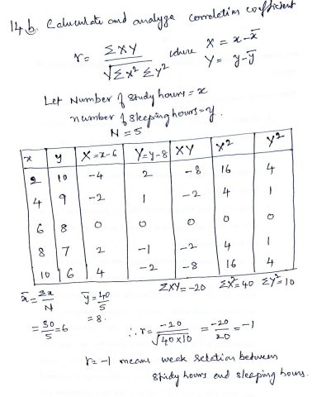

Slide 36
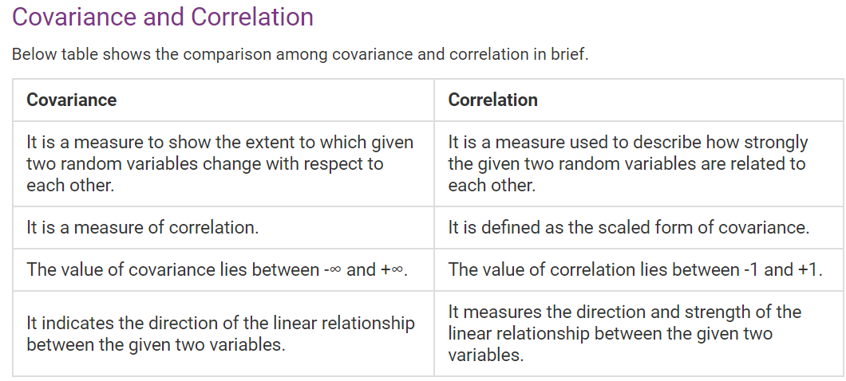

Slide 37
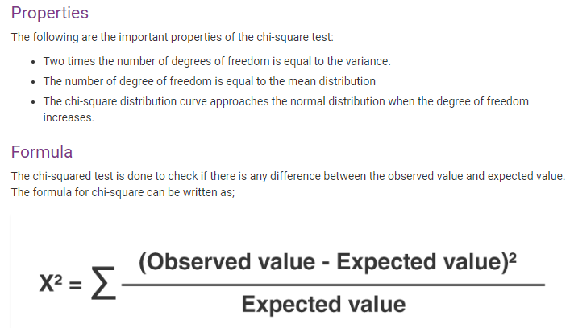
Redundancy and Correlation Analysis: Chi-square Test
A correlation relationship between two categorical (discrete) attributes, A and B, can be discovered by a X² (chi-square) test.

Slide 38
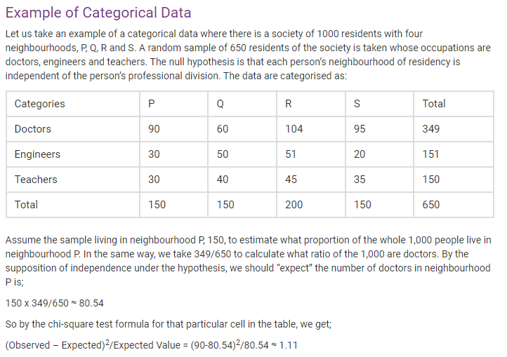

Slide 39
Chi-Square Calculation: An Example
Suppose that a group of 1,500 people was surveyed.
The observed frequency (or count) of each possible joint event is summarized in the contingency table shown
 | Play chess | Not play chess | Sum (row)
Like science fiction | 250(90) | 200(360) | 450
Not like science fiction | 50(210) | 1000(840) | 1050
Sum(col.) | 300 | 1200 | 1500
The numbers in parentheses are the expected frequencies (calculated based on the data distribution for both attributes using Equation e_{ij}).
Are like_science_fiction and play_chess correlated?

Slide 40
Chi-Square Calculation: An Example
For example, the expected frequency for the cell (play_chess, fiction) is
_{e =} count( play _ chess)* count(like_science_fiction) ₌ 300 * 450 ₌ ₉₀
N 1500
11
Notice that
the sum of the expected frequencies must equal the total observed frequency for that row, and
the sum of the expected frequencies in any column must also equal the total observed frequency for that column.

Slide 41
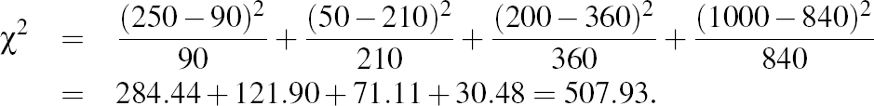
Chi-Square Calculation: An Example
We can get X² by:
For this 2 x 2 table, the degrees of freedom are (2-1)(2-1) = 1. ((no. of rows-1)*(no.of columns-1))
For 1 degree of freedom, the X² value needed to reject the hypothesis at the 0.001 significance level is 10.828 (taken from the table of upper percentage points of the X² distribution, typically available from any textbook on statistics).
Since our computed value is above this, we can reject the hypothesis that play chess and preferred reading are independent and conclude that the two attributes are (strongly) correlated for the given group of people.

Slide 42
III- Data Reduction
Notes:
42

Slide 43
Data Reduction strategies:
Data reduction: Obtain a reduced representation of the data set that is much smaller in volume but yet produces the same (or almost the same) analytical results
Why data reduction? — A database/data warehouse may store terabytes of data. Complex data analysis may take a very long time to run on the complete data set.
Data reduction strategies
1.Data cube aggregation
3. Dimensionality reduction-remove unimportant attributes/variables
Eliminate the redundant attributes: which are weekly important across the data.
Wavelet transforms/ Data compression
Principal Components Analysis (PCA)
Feature subset selection, feature creation
4. Numerosity reduction- replace original data volume by smaller forms of data
Regression and Log-Linear Models
Histograms, clustering, sampling
Data cube aggregation

Slide 44
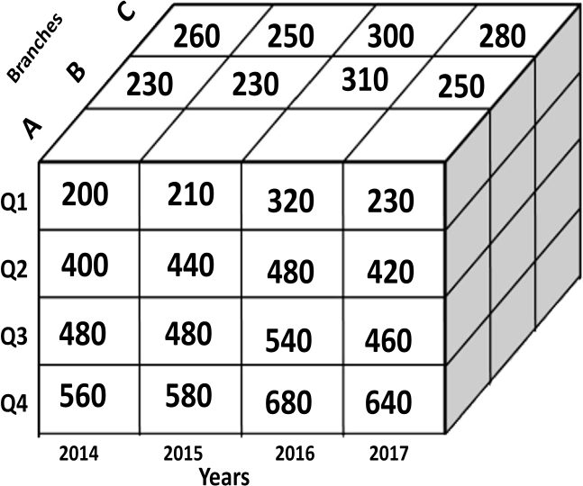
1. Data cube aggregation
For example, the data consists of AllElectronics sales per quarter for the years 2014 to 2017.You are, however, interested in the annual sales, rather than the total per quarter. Thus, the data can be aggregatedso that the resulting data summarize the total sales per year instead of per quarter

Slide 45
2. Dimensionality Reduction
Know about Curse of dimensionality
When dimensionality increases, data becomes increasingly sparse
Density and distance between points, which is critical to clustering, outlier analysis, becomes less meaningful
The possible combinations of subspaces will grow exponentially
What is Dimensionality reduction
Method of eliminating irrelevant features so as to reduce noise
Is proposed to avoid the curse of dimensionality
Reduce time and space required in data mining
Allow easier visualization of data (quite messy to visualize huge data)
Dimensionality reduction techniques
Wavelet transforms
Principal Component Analysis
Supervised and nonlinear techniques (e.g., feature selection)
Notes:
45

Slide 46
Dimensionality Reduction: Wavelet Transform
The discrete wavelet transform (DWT) is a linear signal processing technique that, when applied to a data vector, transforms it to a numerically different vector, of wavelet coefficients.
The two vectors are of the same length. When applying this technique to data reduction, we consider each tuple as an n-dimensional data vector, that is, X=(x₁,x₂,…………,x_{n}), depicting n measurements made on the tuple from n database attributes .
For example, all wavelet coefficients larger than some user-specified threshold can be retained. All other coefficients are set to 0. The resulting data representation is therefore very sparse, so that can take advantage of data sparsity are computationally very fast if performed in wavelet space.
Given a set of coefficients, an approximation of the original data can be constructed by applying the inverse of the DWT used.
Notes:
46

Slide 47
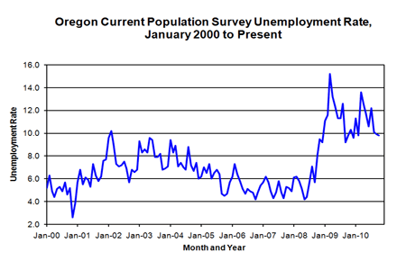
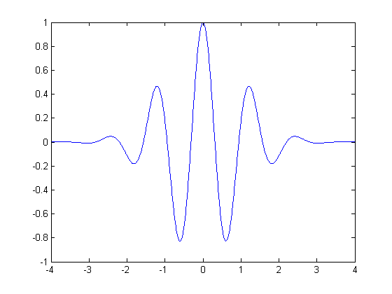
Dimensionality Reduction: Sequence Data and Wavelet Function
Haar2
Daubechie4
A continuous wavelet function

Slide 48
Dimensionality Reduction: Wavelet Transformation
Discrete wavelet transform (DWT): linear signal processing, multi-resolutional analysis
Similar to discrete Fourier transform (DFT), but better lossy compression, localized in space
Method:
Length, L, must be an integer power of 2 (padding with 0’s, when necessary)
Each transform has 2 functions: sum, difference
Applies to pairs of data, resulting in two set of data of length L/2
Applies two functions recursively, until reaches the desired length
Compressed approximation: store only a small fraction of the strongest of the wavelet coefficients

Slide 49
An example
0 1 2 3 4 3 2 1
1 1 -1 -1
1 5 7 3
0 0
2 -2
4 -4
6 10
0 0
-4 0
-8 0
4 16

Slide 50
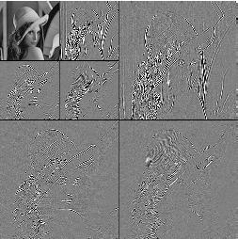
DWT for Image Compression
Image
Low Pass High Pass
Low Pass High Pass
Low Pass High Pass

Slide 51
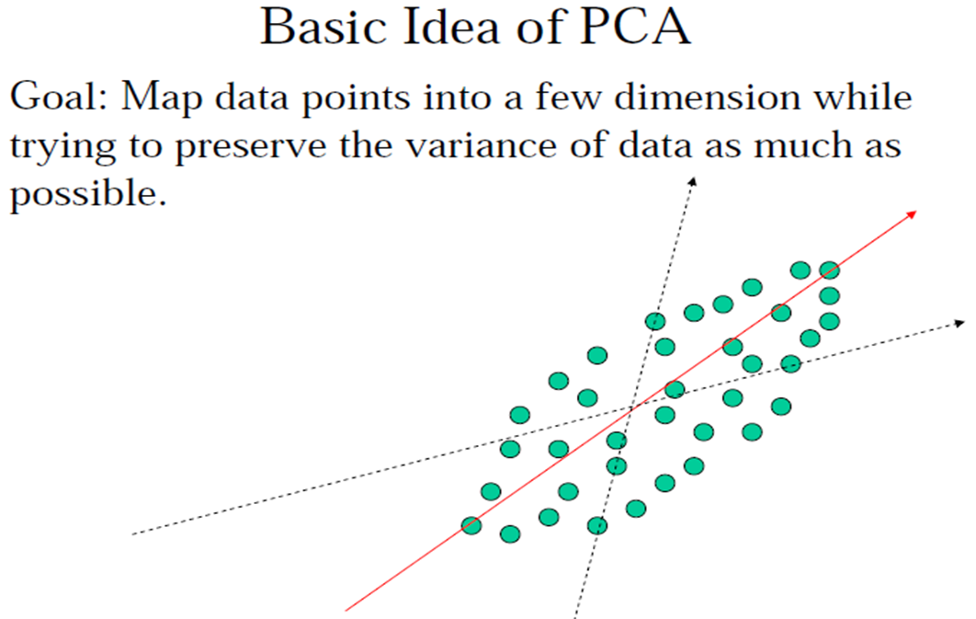
Dimensionality Reduction: Principal Component Analysis (PCA)
Given N data vectors from d-dimensions, find k ≤ d orthogonal vectors (principal components) that can be best used to represent data
Steps
Normalize input data
Compute k orthonormal (unit) vectors, i.e., principal components
The principal components are sorted in order of decreasing “significance” or strength
Since the components are sorted, the size of the data can be reduced by eliminating the weak components, i.e., those with low variance. (i.e., using the strongest principal components, it is possible to reconstruct a good approximation of the original data)
Used when the number of dimensions is large

Slide 52
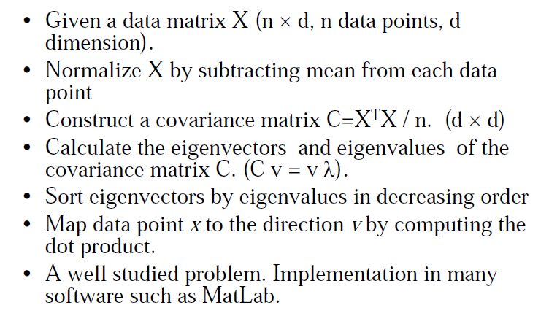
Dimensionality Reduction: PCA Method
(
)
1

Slide 53
Dimensionality Reduction: Attribute Subset Selection
Attribute subset selection reduces the data set size by removing irrelevant or redundant attributes (or dimensions). The goal of attribute subset selection is to find a minimum set of attributes. It reduces the number of attributes appearing in the discovered patterns, helping to make the patterns easier to understand.
To find out a ‘good’ subset from the original attributes
Another way to reduce dimensionality of data
Redundant attributes
Duplicate much or all of the information contained in one or more other attributes
E.g., purchase price of a product and the amount of sales tax paid
Irrelevant attributes
Contain no information that is useful for the data mining task at hand
E.g., students' ID is often irrelevant to the task of predicting students' GPA

Slide 54
Dimensionality Reduction: Heuristic Search in Attribute Selection
There are 2^{d} possible attribute combinations of d attributes
Typical heuristic attribute selection methods:
Best single attribute under the attribute independence assumption: choose by significance tests
Best step-wise( forward) feature selection:
The best single-attribute is picked first
Then next best attribute condition to the first, ...
Step-wise attribute( backward) elimination:
Repeatedly eliminate the worst attribute
Best combined attribute selection and elimination
Decision tree induction
Use attribute elimination and backtracking

Slide 55
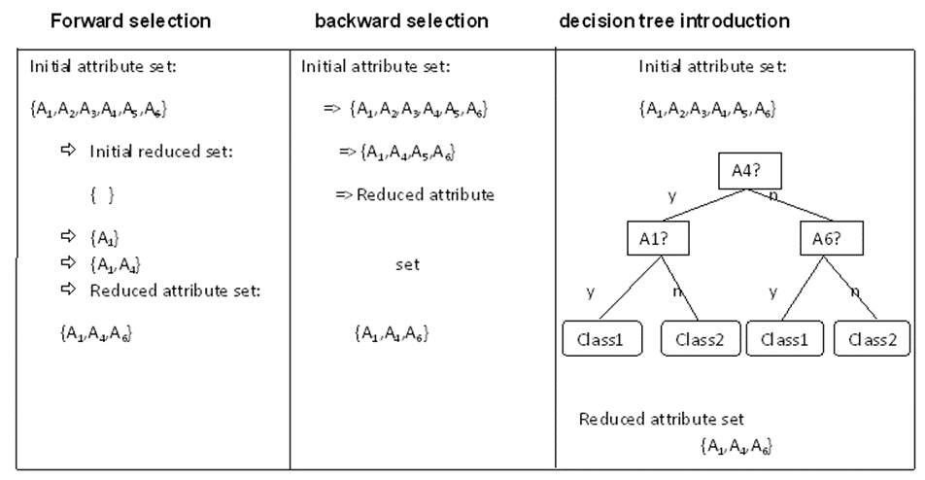
Heuristic Search in Attribute Selection

Slide 56
Dimensionality Reduction: Attribute Creation (Feature Generation)
Create new attributes (features) that can capture the important information in a data set more effectively than the original ones
Three general methodologies
Attribute extraction
Domain-specific
Mapping data to new space (see: data reduction)
E.g., Fourier transformation, wavelet transformation, manifold approaches (not covered)
Attribute construction
Combining features (see: discriminative frequent patterns in Chapter 7)
Data discretization
Notes:
56

Slide 57
3. Numerosity Reduction
Reduce data volume by choosing alternative, smaller forms of data representation
Parametric methods
Regression:
Simple linear regression
Multiple linear regression
Assume the data fits some model, estimate model parameters, store only the parameters, and discard the data (except possible outliers)
Log-linear models—obtain value at a point in m-D space as the product on appropriate marginal subspaces
Non-parametric methods
Do not assume models
Major families: Histograms, Clustering, Sampling, Cube aggregation

Slide 58
Parametric methods: Regression Analysis
Regression analysis: A collective name for techniques for the modeling and analysis of numerical data consisting of values of a dependent variable (also called response variable or measurement) and of one or more independent variables (aka. explanatory variables or predictors)
The parameters are estimated so as to give a "best fit" of the data
Most commonly the best fit is evaluated by using the least squares method, but other criteria have also been used
y
Y1
Y1’
y = x + 1
X1
x
Used for prediction (including forecasting of time-series data), inference, hypothesis testing, and modeling of causal relationships

Slide 59
Parametric methods : Regress Analysis and Log-Linear Models
Linear regression: Y = w X + b
Two regression coefficients, w and b, specify the line and are to be estimated by using the data at hand
Using the least squares criterion to the known values of Y₁, Y₂, …, X₁, X₂, ….
Multiple regression: Y = b₀ + b₁ X₁ + b₂ X₂
Many nonlinear functions can be transformed into the above
Log-linear models:
Approximate discrete multidimensional probability distributions
Estimate the probability of each point (tuple) in a multi-dimensional space for a set of discretized attributes, based on a smaller subset of dimensional combinations
Useful for dimensionality reduction and data smoothing

Slide 60
Nonparametric methods : Histogram Analysis
Divide data into buckets and store average (sum) for each bucket
Partitioning rules:
Equal-width: equal bucket range
Equal-frequency (or equal-depth)

Slide 61
Nonparametric methods : Clustering
Partition data set into clusters based on similarity, and store cluster representation (e.g., centroid and diameter) only
Can be very effective if data is clustered but not if data is “smeared”
Can have hierarchical clustering and be stored in multi-dimensional index tree structures
There are many choices of clustering definitions and clustering algorithms

Slide 62
Nonparametric methods : Sampling
Sampling: obtaining a small sample s to represent the whole data set N
Allow a mining algorithm to run in complexity that is potentially sub-linear to the size of the data
Key principle: Choose a representative subset of the data
Simple random sampling may have very poor performance in the presence of skew
Develop adaptive sampling methods, e.g., stratified sampling:
Note: Sampling may not reduce database I/Os (page at a time)

Slide 63
Nonparametric methods : Types of Sampling
Simple random sampling
There is an equal probability of selecting any particular item
Sampling without replacement
Once an object is selected, it is removed from the population
Sampling with replacement
A selected object is not removed from the population
Stratified sampling:
Partition the data set, and draw samples from each partition (proportionally, i.e., approximately the same percentage of the data)
Used in conjunction with skewed data

Slide 64
Nonparametric methods : Sampling: With or without Replacement
SRSWOR
(simple random
sample without
replacement)
SRSWR
Raw Data

Slide 65
Sampling: Cluster or Stratified Sampling
Raw Data
Cluster/Stratified Sample

Slide 66
Nonparametric methods : Data Cube Aggregation
Data cube aggregation, where aggregation operations are applied to the data for construction of a data cube.
Data cubes store multidimensional aggregated information. Each cell holds an aggregate data value, corresponding to the data point in multidimensional space.
Concept hierarchies may exist for each attribute, allowing the analysis of data at multiple level of abstraction.
Data cubes provide fast access to pre computed summarized data, thereby benefiting on-line analytical processing as well as data mining.
Notes:
66

Slide 67
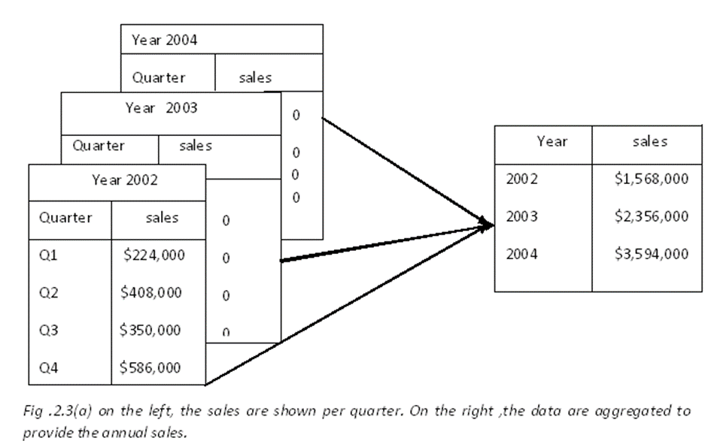
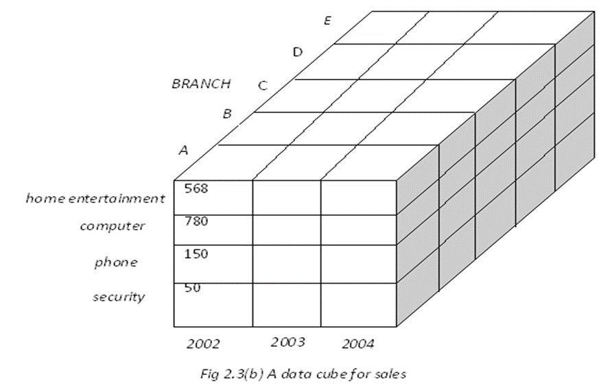
Nonparametric methods : Data Cube Aggregation
The cube can be created in three ways:
Based cuboid- The cube created at the lowest level of abstraction is referred to as base cuboid.
Lattice of cuboids- Data cubes created for varying levels of abstraction are often referred to as cuboids.
Apex cuboid - A cube at highest level of abstraction is the apex cuboid
Notes:
67

Slide 68
IV- Data Transformation
Data transformation
The data are transformed into forms appropriate for mining.
Data transformation tasks:
Smoothing: Remove the noise from the data. Techniques includes Binning, Regression, Clustering.
Normalization
Attribute construction, Subset selection
Aggregation
Discretization
Generalization

Slide 69

Data Transformation Tasks
Normalization
the attribute data are scaled so as to fall within a small specified range, such as -1.0 to 1.0, 0.0 to 1.0
Attribute construction (or feature construction)
new attributes are constructed and added from the given set of attributes to help the mining process.
Aggregation
summary or aggregation operations are applied to the data.
For example, the daily sales data may be aggregated so as to compute monthly and annual total amounts.

Slide 70
Data Transformation Tasks
Discretization
Dividing the range of a continuous attribute into intervals
For example, values for numerical attributes, like age, may be mapped to higher-level concepts, like youth, middle- aged, and senior.
Generalization
where low-level or “primitive” (raw) data are replaced by higher-level concepts through the use of concept hierarchies.
For example, categorical attributes, like street, can be generalized to higher-level concepts, like city or country.

Slide 71
2. Normalization
An attribute is normalized by scaling its values so that they fall within a small specified range, such as 0.0 to 1.0.
Normalization is particularly useful for classification algorithms involving
neural networks
distance measurements such as nearest-neighbor classification and clustering.
If using the neural network backpropagation algorithm for classification mining, normalizing the input values for each attribute measured in the training instances will help speed up the learning phase.
For distance-based methods, normalization helps prevent attributes with initially large ranges (e.g., income) from out-weighing attributes with initially smaller ranges (e.g., binary attributes).
Normalization methods
Min-max normalization
z-score normalization
Normalization by decimal scaling

Slide 72
Min-max Normalization
Min-max normalization
performs a linear transformation on the original data.
Suppose that:
min_{A} and max_{A} are the minimum and maximum values of an attribute, A.
Min-max normalization maps a value, v, of A to v′ in the range [new_min_{A}, new_max_{A}] by computing:
v − minA
v' = (new _ maxA − new _ minA) + new _ minA
maxA − minA

Slide 73
Normalization
Min-max normalization: to [new_min_{A}, new_max_{A}]
Ex. Let income range $12,000 to $98,000 normalized to [0.0, 1.0]. Then $73,000 is mapped to
Z-score normalization (μ: mean, σ: standard deviation):
Ex. Let μ = 54,000, σ = 16,000. Then
Normalization by decimal scaling
Where j is the smallest integer such that Max(|ν’|) < 1

Slide 74
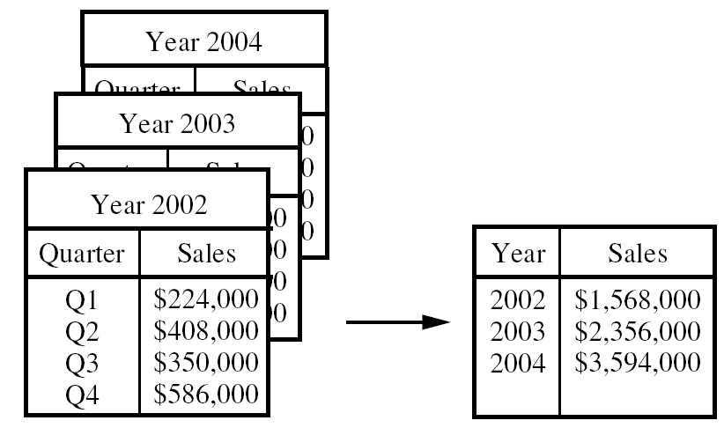
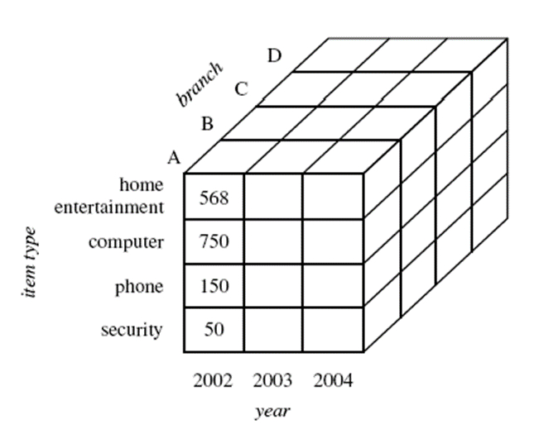
3. Data Aggregation
On the left, the sales are shown per quarter. On the right, the data are aggregated to provide the annual sales
Sales data for a given branch of AllElectronics for the years 2002 to 2004.
Data cubes store multidimensional aggregated information.
Data cubes provide fast access to precomputed, summarized data, thereby benefiting on-line analytical processing as well as data mining.
A data cube for sales at AllElectronics.

Slide 75
4. Attribute Construction
Attribute construction (feature construction)
new attributes are constructed from the given attributes and added in order to help improve the accuracy and understanding of structure in high-dimensional data.
Example
we may wish to add the attribute area based on the attributes height and width.
By attribute construction can discover missing information.
Why attribute subset selection
Data sets for analysis may contain hundreds of attributes, many of which may be irrelevant to the mining task or redundant.
For example,
if the task is to classify customers as to whether or not they are likely to purchase a popular new CD at AllElectronics when notified of a sale, attributes such as the customer’s telephone number are likely to be irrelevant, unlike attributes such as age or music_taste.

Slide 76
Attribute Subset Selection
Using domain expert to pick out some of the useful attributes
– Sometimes this can be a difficult and time-consuming task, especially when the behavior of the data is not well known.
Leaving out relevant attributes or keeping irrelevant attributes result in discovered patterns of poor quality.
In addition, the added volume of irrelevant or redundant attributes can slow down the mining process.
Attribute subset selection (feature selection):
Reduce the data set size by removing irrelevant or redundant attributes
Goal:
select a minimum set of features (attributes) such that the probability distribution of different classes given the values for those features is as close as possible to the original distribution given the values of all features
It reduces the number of attributes appearing in the discovered patterns, helping to make the patterns easier to understand.

Slide 77
Attribute Subset Selection
How can we find a ‘good’ subset of the original attributes?
For n attributes, there are 2^{n} possible subsets.
An exhaustive search for the optimal subset of attributes can be prohibitively expensive, especially as n increase.
Heuristic methods that explore a reduced search space are commonly used for attribute subset selection.
These methods are typically greedy in that, while searching through attribute space, they always make what looks to be the best choice at the time.
Such greedy methods are effective in practice and may come close to estimating an optimal solution.
Heuristic methods:
Step-wise forward selection
Step-wise backward elimination
Combining forward selection and backward elimination
Decision-tree induction
The “best” (and “worst”) attributes are typically determined using:
the tests of statistical significance, which assume that the attributes are independent of one another.
the information gain measure used in building decision trees for classification.

Slide 78
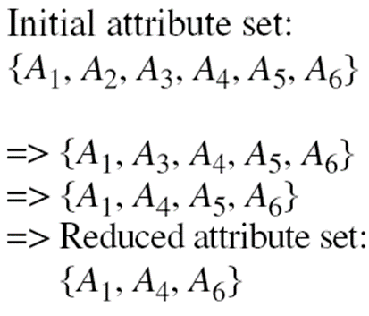
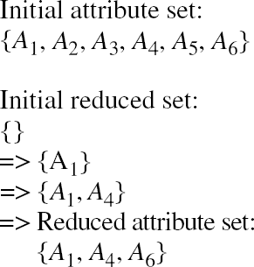
Attribute Subset Selection
Stepwise forward selection:
The procedure starts with an empty set of attributes as the reduced set.
First: The best single-feature is picked.
Next: At each subsequent iteration or step, the best of the remaining original attributes is added to the set.
Stepwise backward elimination:
The procedure starts with the full set of attributes.
At each step, it removes the worst attribute remaining in the set.
Combining forward selection and backward elimination:
The stepwise forward selection and backward elimination methods can be combined
At each step, the procedure selects the best attribute and removes the worst from among the remaining attributes.

Slide 79
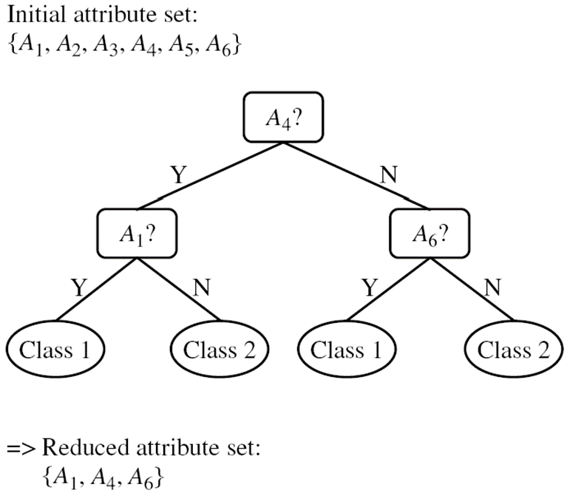
Attribute Subset Selection
Decision tree induction:
Decision tree algorithms, such as ID3, C4.5, and CART, were originally intended for classification.
Decision tree induction constructs a flowchart-like structure where each internal (nonleaf) node denotes a test on an attribute, each branch corresponds to an outcome of the test, and each external (leaf) node denotes a class prediction.
At each node, the algorithm chooses the “best” attribute to partition the data into individual classes.
When decision tree induction is used for attribute subset selection, a tree is constructed from the given data.
All attributes that do not appear in the tree are assumed to be irrelevant.

Slide 80
5. Generalization
Generalization is the generation of concept hierarchies for categorical data
Categorical attributes have a finite (but possibly large) number of distinct values, with no ordering among the values.
Examples include
geographic location,
job category, and
itemtype.
A relational database or a dimension location of a data warehouse may contain the following group of attributes: street, city, province or state, and country.
A user or expert can easily define a concept hierarchy by specifying ordering of the attributes at the schema level.
A hierarchy can be defined by specifying the total ordering among these attributes at the schema level, such as:
street < city < province or state < country

Slide 81
6. Discretization
Three types of attributes:
Nominal — values from an unordered set, e.g., color, profession
Ordinal — values from an ordered set, e.g., military or academic rank
Continuous — real numbers, e.g., integer or real numbers
Discretization:
Divide the range of a continuous attribute into intervals
Some classification algorithms only accept categorical attributes.
Reduce data size by discretization

Slide 82
Discretization and Concept Hierarchy
Discretization
Reduce the number of values for a given continuous attribute by dividing the range of the attribute into intervals
Interval labels can then be used to replace actual data values
Supervised vs. unsupervised
Split (top-down) vs. merge (bottom-up)
Discretization can be performed recursively on an attribute
Concept hierarchy formation
Recursively reduce the data by collecting and replacing low level concepts (such as numeric values for age) by higher level concepts (such as young, middle-aged, or senior)

Slide 83
Discretization and Concept Hierarchy Generation for Numeric Data
Typical methods: All the methods can be applied recursively
Binning
Top-down split, unsupervised,
Histogram analysis
Top-down split, unsupervised
Clustering analysis
Either top-down split or bottom-up merge, unsupervised
Entropy-based discretization: supervised, top-down split
Interval merging by χ² Analysis: supervised, bottom-up merge

Slide 84
Entropy-Based Discretization
Entropy is calculated based on class distribution of the samples in the set. Given m classes, the entropy of S₁ is
where p_{i} is the probability of class i in S₁
Given a set of samples S, if S is partitioned into two intervals S₁ and S₂ using boundary T, the information gain after partitioning is
The boundary that minimizes the entropy function over all possible boundaries (i.e. maximize information is selected as a binary discretization)
The process is recursively applied to partitions obtained until some stopping criterion is met
Such a boundary may reduce data size and improve classification accuracy

Slide 85
Interval Merge by χ² Analysis
Merging-based (bottom-up) vs. splitting-based methods
Merge: Find the best neighboring intervals and merge them to form larger intervals recursively
ChiMerge [Kerber AAAI 1992, See also Liu et al. DMKD 2002]
Initially, each distinct value of a numerical attr. A is considered to be one interval
χ² tests are performed for every pair of adjacent intervals
Adjacent intervals with the least χ² values are merged together, since low χ² values for a pair indicate similar class distributions
This merge process proceeds recursively until a predefined stopping criterion is met (such as significance level, max-interval, max inconsistency, etc.)

Slide 86
Concept Hierarchy Generation for Categorical Data
Specification of a partial/total ordering of attributes explicitly at the schema level by users or experts
street < city < state < country
Specification of a hierarchy for a set of values by explicit data grouping
{Urbana, Champaign, Chicago} < Illinois
Automatic generation of hierarchies (or attribute levels) by the analysis of the number of distinct values
E.g., for a set of attributes: {street, city, state, country}

Slide 87
Automatic Concept Hierarchy Generation
Some hierarchies can be automatically generated based on the analysis of the number of distinct values per attribute in the data set
The attribute with the most distinct values is placed at the lowest level of the hierarchy
Exceptions, e.g., weekday, month, quarter, year
country
15 distinct values
province_or_ state
365 distinct values
city
3567 distinct values
street
674,339 distinct values

Slide 88
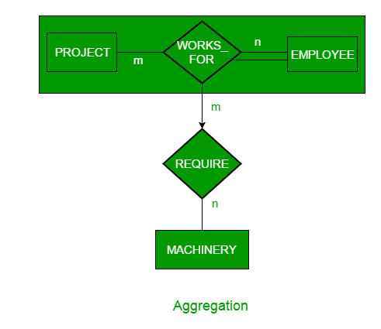
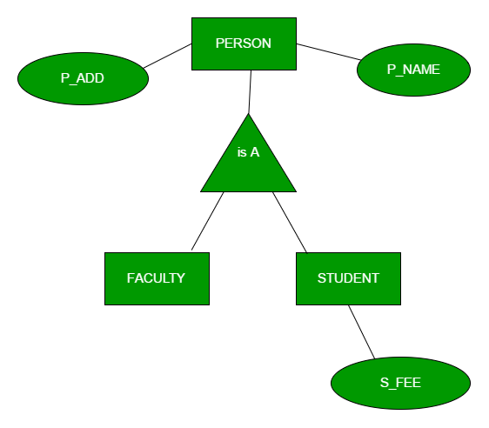
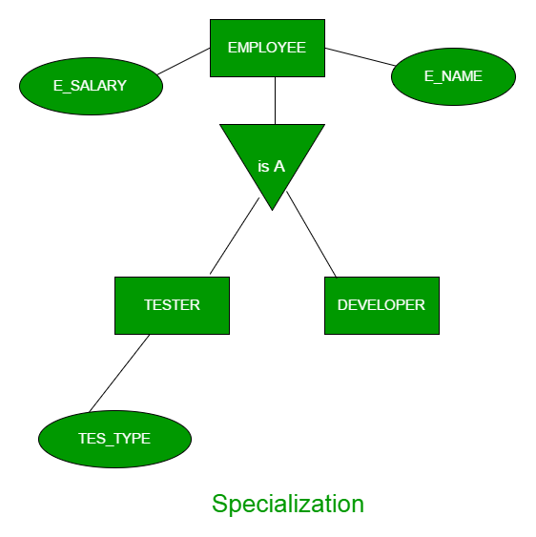
Generalization , specialization, Aggregation
Generalization is the process of extracting common properties from a set of entities and create a generalized entity from it
In specialization, an entity is divided into sub-entities based on their characteristics. It is a top-down approach where higher level entity is specialized into two or more lower level entities
Aggregation is an abstraction through which we can represent relationships as higher level entity sets.

